Slide 1
3 properties of elements
Atomic radius
Ionisation energy
Electronegativity

Slide 2
Atomic radius
½ distance between 2 nuclei of two atoms of the same element that are joined together by a single covalent bond.
It is possible for scientists to measure experimentally the distance between the nuclei of 2 atoms.
This is known as bond length and is measured using x-ray diffraction. Usually in nanometres.
See table …. On page …. Of your maths tables

Slide 3
What do we notice?

Slide 4
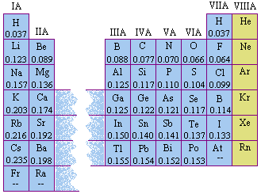
What do you notice?

Slide 5
The values of atomic radii decrease going across a period. Why?
Increase in effective nuclear charge. Increase in no. of protons in nucleus. These extra protons attract the outer electrons to draw energy levels closer to nucleus.
No increase in screening effect. The addition of an electron going across a period is not added to a new energy level each time. There is an increase in the effective nuclear charge.

Slide 6
The values of atomic radii increase going down a group. Why? Must give 2 reasons
As we go down a group there is a new energy level which is further from the nucleus.
Screening effect. Even though nuclear charge increases this is counteracted by the shielding effect of the inner energy levels of electrons.

Slide 7
Trends in Ionisation energy
1st ionisation of an atom is minimum energy required to remove the most loosely bound electron from a neutral gaseous atom in its ground state.

Slide 8
1st Ionisation energy decreases going down a group why?
Increase in atomic radius
Screening effect of inner electrons.

Slide 9
Ionisation energy increase going across a period . Why?
decreasing atomic radius
Increase in nuclear charge

Slide 10
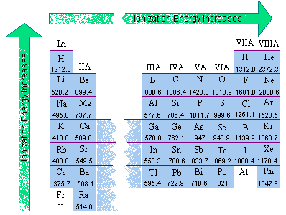
Exceptions

Slide 11
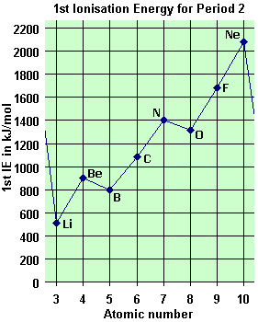
Plot a Graph of 1st ionisation (y-axis against atomic no. (x-axis) for elements in period 2.
Identify exceptions to thus trend.

Slide 12
Exceptions
Be > B
N > O
1s², 2s²
Beryllium has a full 2s sublevel. This gives an atom of Be extra stability so more energy than expected is needed to remove it’s most loosely bound electron
1s², 2s²,2p³
Nitrogen has a half full 2p sublevel. This gives an atom of N extra stability so more energy than expected is needed to remove it’s most loosely bound electron

Slide 13
Can you explain
Mg > Al
P > S

Slide 14
Trends in electronegativity Is relative force of attraction that an atom has for the shared pair of electrons in a covalent bond
Going across a period
Going down a group
Electronegativity increase
Due to increase in nuclear charge
Decreasing atomic radius
Electronegativity decreases
Increased atomic radius
Screening effect

Slide 15
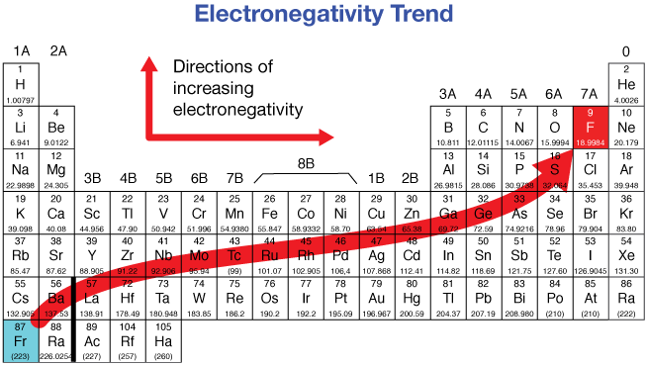
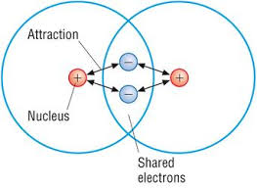
Electonegativity

Slide 16
Second ionisation
E required to remove an electron from an ion with one positive charge in a gaseous state
X⁺_{(g)} X⁺_{(g)} + e⁻
Make sure to include (g) symbol as def states in gaseous state

Slide 17
Second ionisation E
Potassium =1s², 2s²,2p^{6,} 3s², 3p⁶,4s¹
2nd ionisation E is much higher than 1st ionisation E as it involves removing an electron from a full 3p sublevel. The large difference in 1st and 2nd ionisation gives use evidence for existence of energy levels as the electron being removed from the 3p is closer to nucleus and experiences less shielding.

Slide 18
There is a steady increase in ionisation energy values as electrons are removed from an atom.
Reason 1
Reason 2
For every electron that is removed the nuclear charge is increasing.
Large increase in IE when an electron is being removed from a new energy level.

Slide 19
Classic mistakes noted when correcting questions on this topic.
Not learning ionisation energy def. accurately.
Not labelling axes on graphs
Mixing energy levels/sub levels and orbitals
Emphasize in your answer that a ½ filled or full filled sublevel makes an atom more stable.
Bohr diagrams being used instead of Dot and cross diagrams .
Use specific language like going across table effective nuclear charge increase and atomic radius decreases. Don’t waffle!

