Slide 1

Moyle Park College
The story of the Raspberry pi

Slide 2
Bridge-21 Drop in Workshops
Digital media
Scratch
Python
Raspberry pi

Slide 3
A digital media project on Stand-Up week using Scratch

Slide 4
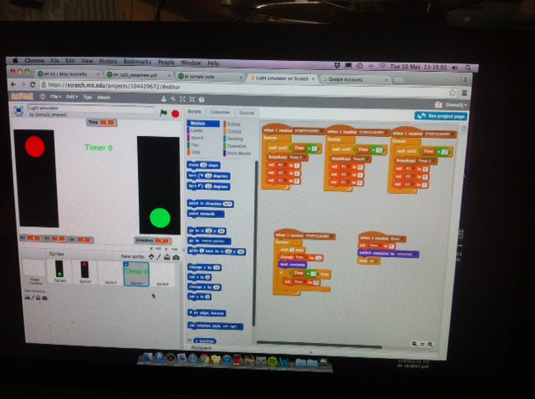
Luke and Dominic’s algorithm on scratch for traffic lights

Slide 5
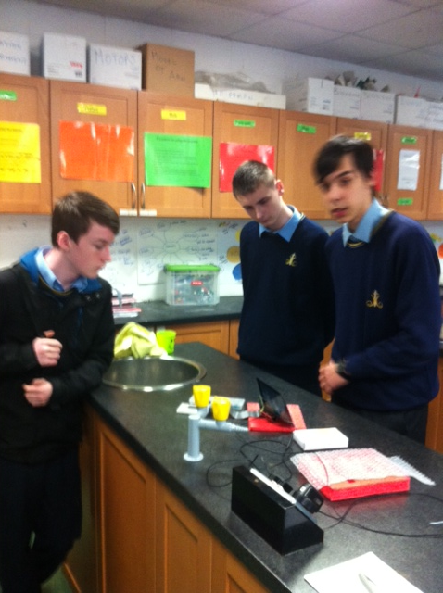
Our inaugural Raspberry pi meet up
Set-up
Monitor
VGA HDMI
T-Cobbler
Breadboard
Regular phone charger
Funded by science department yearly budget

Slide 6
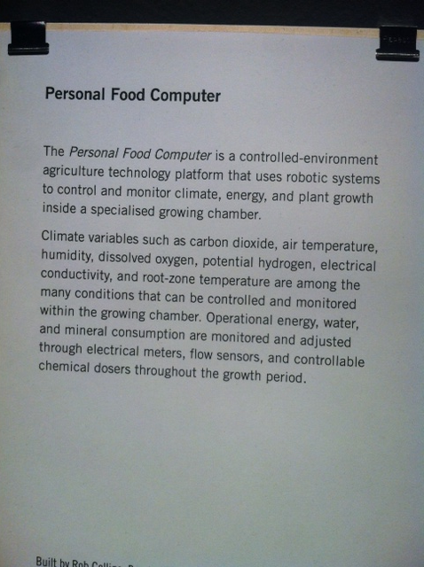
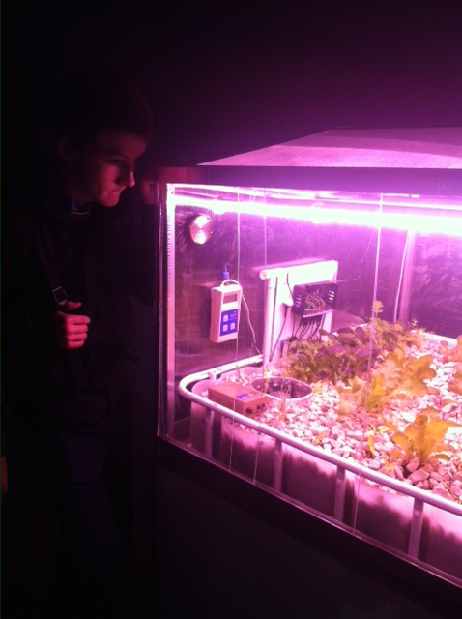
Science gallery photos
Can you spot the raspberry pi?

Slide 7
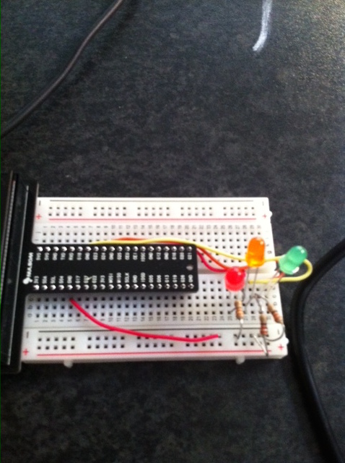
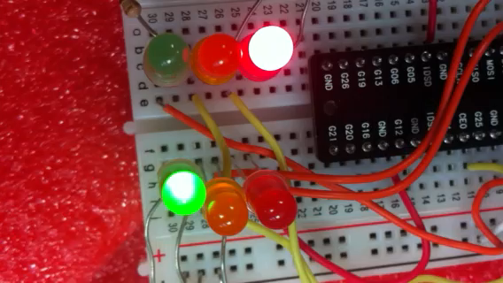
Video of traffic lights

Slide 8
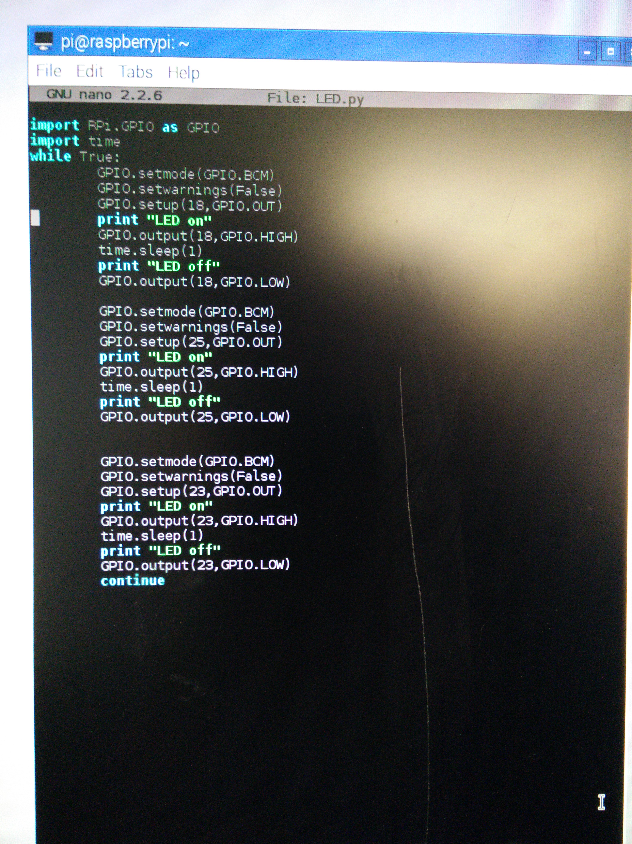
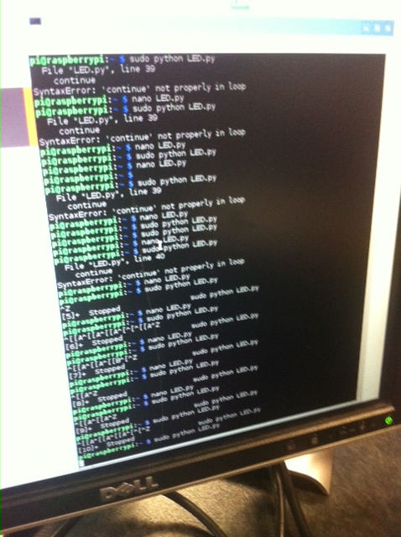
Algorithm for traffic lights using Python
LEDS work
LEDS operating in a traffic light sequence-What is the program doing

Slide 9
Sharing our knowledge with the engineering class.

Slide 10
3 more Raspberry pictures on the way
Show picture of shopping list

Slide 11
What have we achieved
Our project is encouraging students to be self-directed, independent thinkers and learners.
We are discovering different ways of designing and using learning spaces. The students are at complete ease collaborating and sharing ideas.
The experience has allowed me to become a facilitator of my students’ learning.

Slide 12
Aims for 2016-2017
We aim to develop and expand an active learning community within the school using the Raspberry –pi lunchtime meet-up.
We would like to expand the use of this technology into everyday science and IT classes at all stages of secondary school.
I hope to enroll in the post-graduate certificate in 21st Teaching in Learning next year.

Slide 13
We would hope to integrate sensors into experiments using:
pH meters and temperature in chemistry
lasers and motion in physics
Temperature and light in Biology

Slide 14
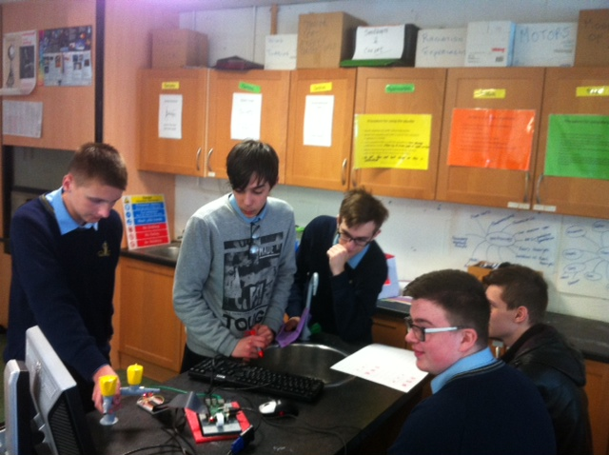
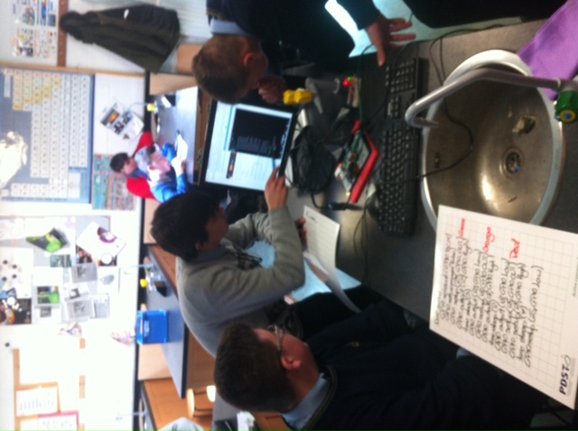
A project in progress

